Slide 1
A54 Waibibabu
LSTM-Based Accelerator for Data Processing
Discord name | Affiliation | Experience | Role
hank_chen_0326 | Cornell University | Master graduate | RTL2GDS Flow Study
digitalguyalan | University of California, Los Angeles | Master graduate | Synthesis and Physical Design
cissy07838 | University of Southern California | Post-graduate | RTL Design
sam092462 | University of Massachusetts Amherst | Master graduate | Physical Design
director_sun | Cornell University | Master graduate | RTL2GDS Flow Study
Presentation video:
Notes:
Good day everyone. We are Group A54 Waibibabu. This project is a compact GF180 digital accelerator prototype for quantized LSTM inference.

Slide 2
Design Objectives
Build a compact GF180 digital accelerator prototype for quantized LSTM inference using a small SRAM buffer and reused MAC datapath.
Target Specifications
Parameters | Specifications
Area | Block A (1100x1100um)
Precision | INT8
Target clk | 50 Mhz
Precision | Q1.7 Fixed point
Input pin | 12
Output pin | 2
InOut pin | 8 (used to be separate in and out data bus)
Implement a small quantized LSTM datapath in RTL. Use INT8 input, weights and gate outputs.
Use a shared MAC datapath to reduce area.
Store intermediate data and weights in a small SRAM buffer.
Verify hardware output against a Python golden model.
The final LSTM outputs are stored in SRAM, not directly exposed as output pins. (Power/ground pins: VDD and VSS are added separately)
Notes:
The main goal is not to store a full neural-network model on chip, but to verify a small LSTM datapath under the Block A area constraint.
The design uses INT8, Q1.7 fixed-point data, a small SRAM buffer, and a reused MAC datapath to save area. The final hidden and cell-state outputs are written back to SRAM instead of being directly exposed as output pins.

Slide 3
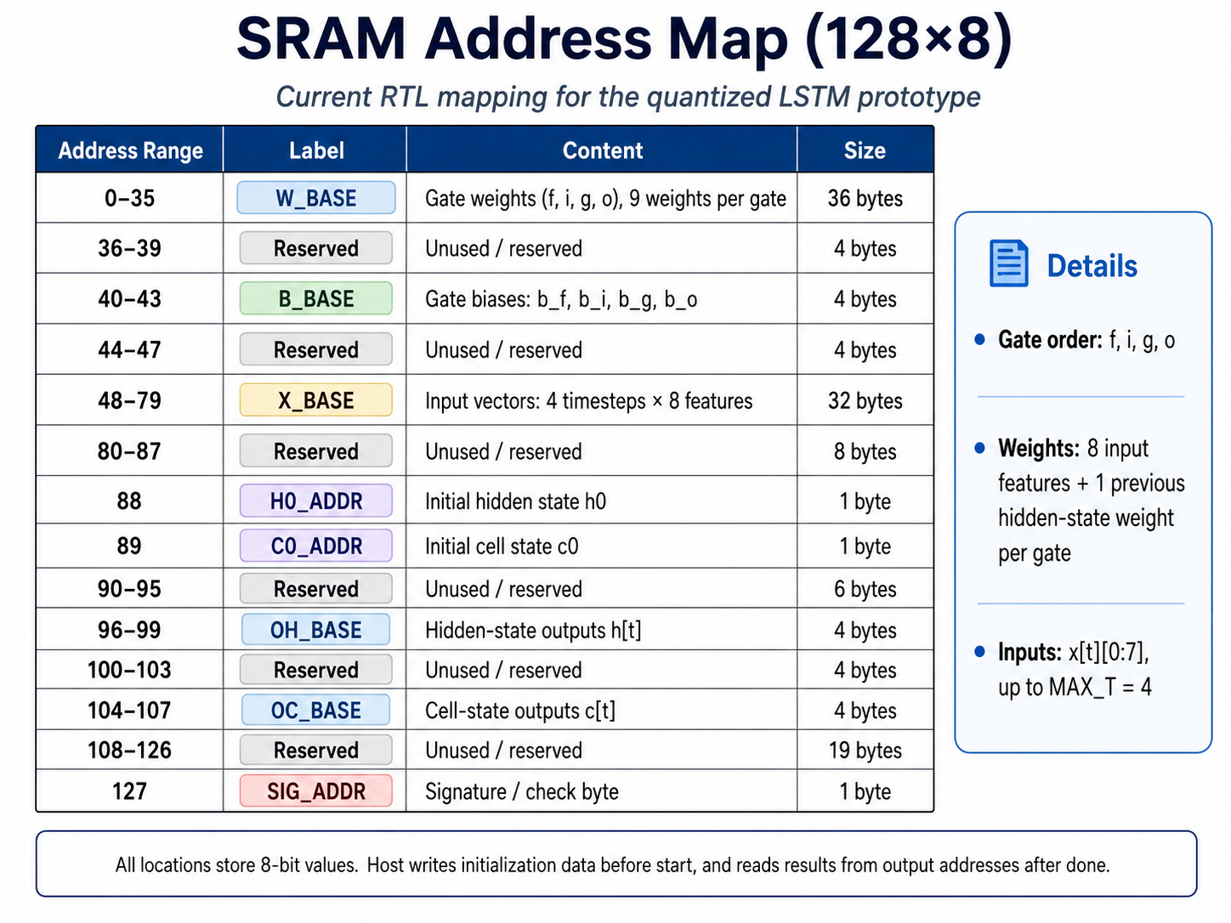
Design Objectives
Target Specifications
Signal | Direction | Width | Purpose
clk | input | 1 | System clock
rst_n | input | 1 | Active-low reset
start | input | 1 | Start LSTM computation
host_en | input | 1 | Host SRAM access enable
host_we | input | 1 | Host write/read select
host_addr[6:0] | input | 7 | SRAM address
host_data[7:0] | inout | 8 | Shared host write/read data bus
busy | output | 1 | Core is using SRAM
done | output | 1 | Computation finished
Notes:
This slide shows the planned top-level interface. The host first loads data into SRAM through the host interface.
After that, start triggers the LSTM computation.
The busy signal indicates that the core is using SRAM, and done indicates the computation has finished. Because of the pin limit, the plan is to use an 8-bit bidirectional host data bus for both SRAM write and read access.

Slide 4
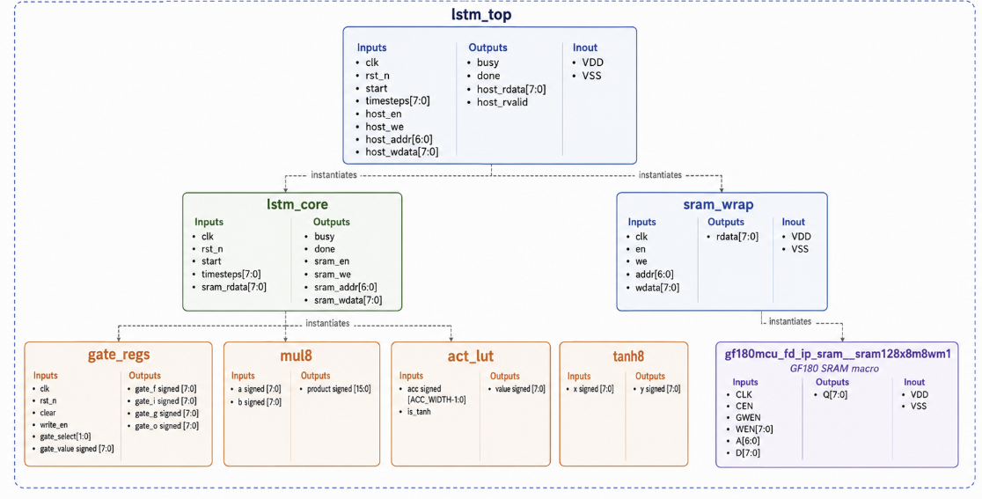
System Overview
• act_lut is used during gate computation: sigmoid for f/i/o, tanh for candidate g • tanh8 is used after c_next is computed: h_next = o × tanh(c_next) • They are separated because the inputs come from different stages: act_lut input = MAC accumulator tanh8 input = updated cell state c_next
Design Assumptions
Quantized INT8 data format is used for inputs, weights, gate values, and stored states.
One LSTM state is processed sequentially rather than using a parallel gate array.
Weights and inputs are stored in the SRAM address map before computation starts.
Activation functions are approximated using small 32-value LUTs (concerned).
Notes:
The design uses quantized INT8 data for inputs, weights, gate values, and states.
One LSTM state is processed sequentially, rather than computing all gates in parallel.
Weights and inputs are stored in the SRAM address map before computation starts.
For activation, act_lut is used after the MAC accumulation: sigmoid is used for f, i, and o gates, and tanh is used for the candidate g gate.
A separate tanh8 block is used after c_next is computed, because h_next needs o multiplied by tanh of the updated cell state.
So these two LUTs are separated because their inputs come from different computation stages.

Slide 5
Schematic Summary
Block | Description
lstm_top | Top-level wrapper. It connects the host interface, LSTM core, and SRAM wrapper. It also contains the SRAM ownership mux controlled by busy. Internal assign logic inside lstm_top. When busy=0, host signals drive SRAM. When busy=1, lstm_core signals drive SRAM. This prevents host/core access conflict.
lstm_core | Main computation controller. It runs the LSTM FSM, reads data from SRAM, computes gates sequentially, updates cell/hidden states, and writes results back to SRAM.
sram_wrap | Interface adapter between RTL logic and the GF180 SRAM macro. It converts simple active-high en/we controls into the SRAM macro’ s active-low control signals.
GF180 SRAM Macro | 128×8 on-chip SRAM used as unified storage for weights, biases, input vectors, states, and output results.
mul8 | Signed 8×8 combinational multiplier. It is reused sequentially for dot-product accumulation and state-update products to reduce area.
gate_regs | Stores the four activated LSTM gate values: forget f, input i, candidate g, and output o.
act_lut | Activation lookup table for gate outputs. It provides sigmoid-style activation for f/i/o gates and tanh-style activation for the candidate g gate.
tanh8 | Separate tanh lookup table used after cell-state update. It computes tanh(c_next) for the hidden-state equation h_next = o × tanh(c_next).
Notes:
The schematic is organized around lstm_top, lstm_core, sram_wrap, and a few small datapath blocks.
lstm_top connects the host interface, the core, and SRAM.
lstm_core is the main FSM, which reads data from SRAM, computes the four gates sequentially, updates the states, and writes results back.
sram_wrap adapts the simple RTL SRAM signals to the GF180 SRAM macro interface.
The multiplier, gate registers, and LUTs are reused to keep the design compact.

Slide 6
Schematic Summary
lstm_top
• Top-leve connecting host, core and SRAM
• Contains SRAM choose mux controlled by busy
busy / SRAM Ownership
• busy=0: host owns SRAM
• busy=1: lstm_core owns SRAM
lstm_core
• Main FSM for sequential LSTM computation
• Reads weights/inputs/states from SRAM
• Computes f/i/g/o gates and update states
sram_wrap + GF180 SRAM
• sram_wrap adapts signals to GF180 SRAM macro
• SRAM stores weights/ biases/ inputs/ states and outputs
mul8 Reuse
• One signed 8×8 multiplier reused across all gates
• Area-saving design, but computation is sequential
Activation
• act_lut: gate activation for f/i/o and g
• tanh8: computes tanh(c_next) for h_next update
Host/Testbench
• External to RTL; used to initialize SRAM and read results. Drives host_* signals, asserts start, waits for done
Notes:
The key idea is SRAM ownership control. When busy is low, the host owns SRAM and can load inputs, weights, and biases or read back results.
When busy is high, the LSTM core owns SRAM.
The core first reads the previous hidden and cell states, then reads the input vector.
For each gate, it reads the bias and weights, reuses one signed 8-bit multiplier for MAC accumulation, applies activation, and stores the gate result.
After all four gates are computed, it updates c_next and h_next and writes them back to SRAM.

Slide 7
Verification Status
Design Checklist
Task | Status
✅ System Architecture | Completed
✅ Design Specifications | Completed
🚧 RTL Design | In Progress
🚧 RTL Verification | In Progress
Current verification focuses on RTL simulation with deterministic test vectors.
• trace_acc_q214.hex: MAC accumulator reference • trace_gate_q17.hex: f/i/g/o gate reference
• trace_c_next_q17.hex: cell-state reference • trace_h_next_q17.hex: hidden-state reference
Python-generated golden outputs will be used to check gate values and final state outputs.
TB acts as the external host testcase_init.hex initializes the 128-byte SRAM image.
start triggers the LSTM core after SRAM loading
Notes:
For verification, the system architecture and design specifications are mostly completed, while RTL design and RTL verification are still in progress.
The current testbench acts as the external host. It initializes the 128-byte SRAM image, asserts start, waits for done, and then compares hardware results with Python-generated golden references.
(The reference traces include MAC accumulator values, gate outputs, cell-state results, and hidden-state results.)

Slide 8
Open Issues
SRAM macro integration in GF180 flow still needs to be confirmed.
Final area after synthesis and placement is not yet fixed.
Activation LUT accuracy is approximate and needs further optimization.
Timing impact of sequential FSM and MAC datapath needs synthesis result.
Notes:
There are four main open issues. First, GF180 SRAM macro integration in the RTL-to-GDS flow still needs to be confirmed.
Second, the final area is not fixed until synthesis and placement are completed.
Third, the 32-entry activation LUT is approximate, and simulation shows that many values are concentrated around the middle LUT entries.
Finally, the timing impact of the sequential FSM and reused MAC datapath still needs synthesis results.

Slide 9
Questions for Reviewers
1. SRAM-Based Architecture Is the current SRAM-based architecture reasonable for the GF180 area constraint? The design uses one small 128×8 SRAM as unified storage for weights, biases, input vectors, states, and output results. Are there concerns about integrating the GF180 SRAM macro through sram_wrap?
2. Activation Approximation The current RTL uses 32-entry LUTs to approximate sigmoid and tanh. In simulation, the mapped values are concentrated around the middle LUT entries, and the approximation accuracy is not very high. Do you have suggestions for improving the activation implementation while keeping the area small? For example, should we use a larger LUT, non-uniform LUT indexing, piecewise-linear approximation, hard-sigmoid / hard-tanh, or adjust the quantization scaling?
3. Are there any required target clock frequency or timing constraints for the project?
Notes:
Here are some concerns for the design.
first question is about the RTL-to-GDS flow setup. Before replacing the tutorial design with my own SRAM-based LSTM RTL, we first tried to run the provided GitHub/Jupyter Notebook 02_rtl2gds_chip_top_custom.ipynb LibreLane tutorial flow using the original demo design. However, the flow already fails at the Yosys synthesis stage, so I have not been able to complete the reference flow yet.
Second, do reviewers have suggestions for improving the activation approximation while keeping area small?.
Third, we list 50 MHz as a tentative target, but we would like to know whether there is an official clock-frequency requirement.

Slide 10
Questions for Reviewers
4. LSTM Functionality vs. MAC-Only Fallback Since the LSTM update requires sigmoid and tanh for the gate and state computations, removing activation logic would reduce the design to mostly MAC operations. For this schematic review stage, is the current approximate activation approach acceptable, or should we simplify the project to verified gate/MAC computation first?
5. Pin-Limited Interface Because of the pin-count, we plan to merge host write data and read data into an 8-bit bidirectional host_data[7:0] bus at the chip boundary. Is this acceptable for the GF180 pad/interface setup?
6. RTL-to-GDS Flow Strategy The RTL is split into multiple modules, including lstm_top, lstm_core, sram_wrap, gate_regs, mul8, act_lut, and tanh8. Would you recommend running the RTL-to-GDS flow directly with the full design first, or hardening some blocks separately as macros and then integrating them at the top level?
Notes:
Since LSTM needs sigmoid and tanh, removing activation would reduce the project to mostly MAC computation. So we want to ask whether approximate activation is acceptable at this schematic review stage, or whether we should first focus on verified MAC and gate computation.
Also, because of the pin limit, we plan to use an 8-bit bidirectional host_data bus.
Finally, since the RTL has multiple small modules, we would like feedback on whether to run the full design directly through RTL-to-GDS first, or harden some blocks separately as macros.

